Slide 1
Problem Solving with C Programming Language
Unit 1: Introduction to C Programming Language

Slide 2
A Brief History of C Programming Language
C is a general-purpose high-level computer programming language. It was created in the 1970s by Dennis Ritchie.
By design, C's features cleanly reflect the capabilities of the targeted CPUs. It is used in operating systems, device drivers, protocol stacks, and application software.
C was originally developed at Bell Labs by Dennis Ritchie between 1972 and 1973 to construct utilities running on Unix.
During the 1980s, C gradually gained popularity. It has become one of the most widely used programming languages, with C compilers available for almost all modern computer architectures and operating systems.
C has been standardized by ANSI since 1989 (ANSI C) and by the International Organization for Standardization (ISO).
C is an imperative procedural language supporting structured programming, lexical variable scope, and recursion, with a static type system.

Slide 3
How to Develop a Software Program?
Developing a software program to solve a problem is like writing an article to tell a story.
When write an article, we first organize the ideas of the story and than express the ideas in a language that the readers can understand. When develop a software program, we must first design the solution of a problem and than express the solution in a way that a computer can understand.
Designing the solution of a problem is to transform the problem into step by step procedures that are logically correct and satisfy the problem specification.
For example, to add up a sequence of 100 numbers, one must consider how these numbers are represented and how to perform proper operations of of the summation.
Mathematically, we can express the numbers abstractly as a₁, a₂, …, a₁₀₀. Then, the sum of the sequence of numbers is written as an arithmetic formula a₁+a₂+…+a₁₀₀.

Slide 4
How to Develop a Software Program? (cont’d)
To solve the problem using a computer, one must think how this problem is represented and expressed it in a computer.
In a computer the sequence of numbers a₁, a₂, …, a₁₀₀ and the sum are stored in memory and the formula a₁+a₂+…+a₁₀₀ must be expressed in a way that can be understood by a computer.
That is, the solutions must be written in a "language" that a computer can understand. Like people communicate with a natural language such as Chinese, English, and Japanese, etc., a person communicate with a computer with a programming language such as C and Java.
The study of a programming language are divided into three aspects: syntax, semantics, and pragmatics.
Syntax is the form of a programming language that is the grammatical rules.
Semantics is the meaning of language constructs.
Pragmatics is the usage of a programming language.

Slide 5
Integrated Development Environment--Dev-C⁺⁺
When we develop a software program, we must write the program using a software tool. Usually, there are two important tools are needed.
The first tool is an editor on which we can enter the program text.
Basically, any text editor, e.g., Microsoft Note and Ultra Editor will do the job. The program text is usually an English text which is not understood by a CPU.
Another tool is a compiler which will be translated the programming text into a sequence of codes that a CPU can understand, i.e., can execute.
Examples of compilers for C programming language are GNU C, Microsoft Visual C++, Turbo C++.
In fact, a tool like Microsoft Visual C++ is a combination of an editor and a compiler, also known as integrated development environment.
In this course we will use a free software tool called Dev-C++ by Bloodshed Software. Dev-C++ is also a tool consisted of an editor and a compiler, GNU C/C++ compiler.

Slide 6
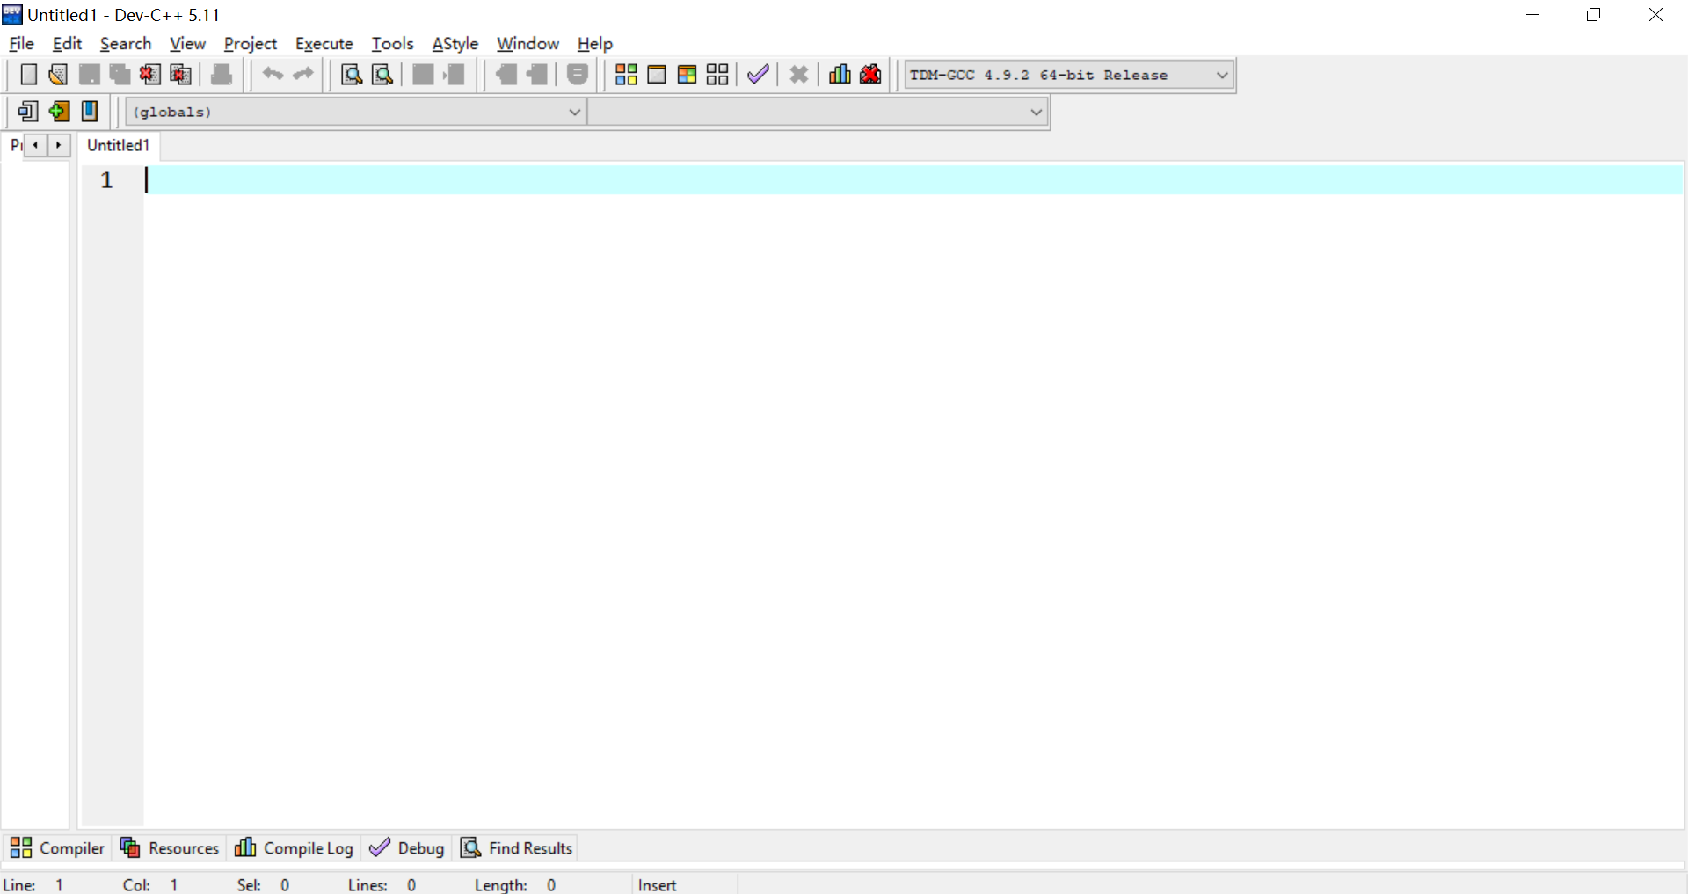
The main window of Dev-C++. The sub-window "Untitled1" is the editor area to enter program text.

Slide 7
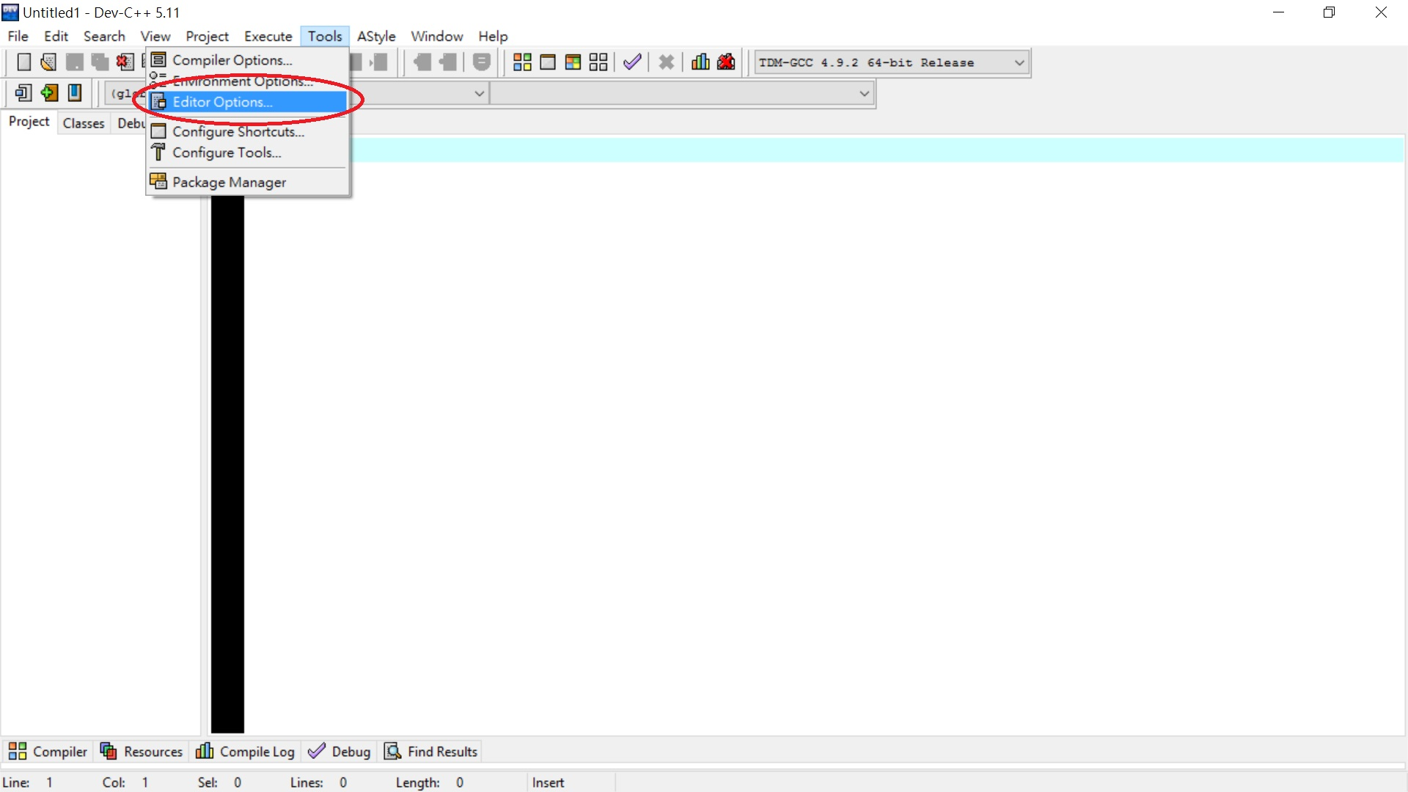
This window can be customized by clicking "Tools" and selecting "Editor Options".

Slide 8
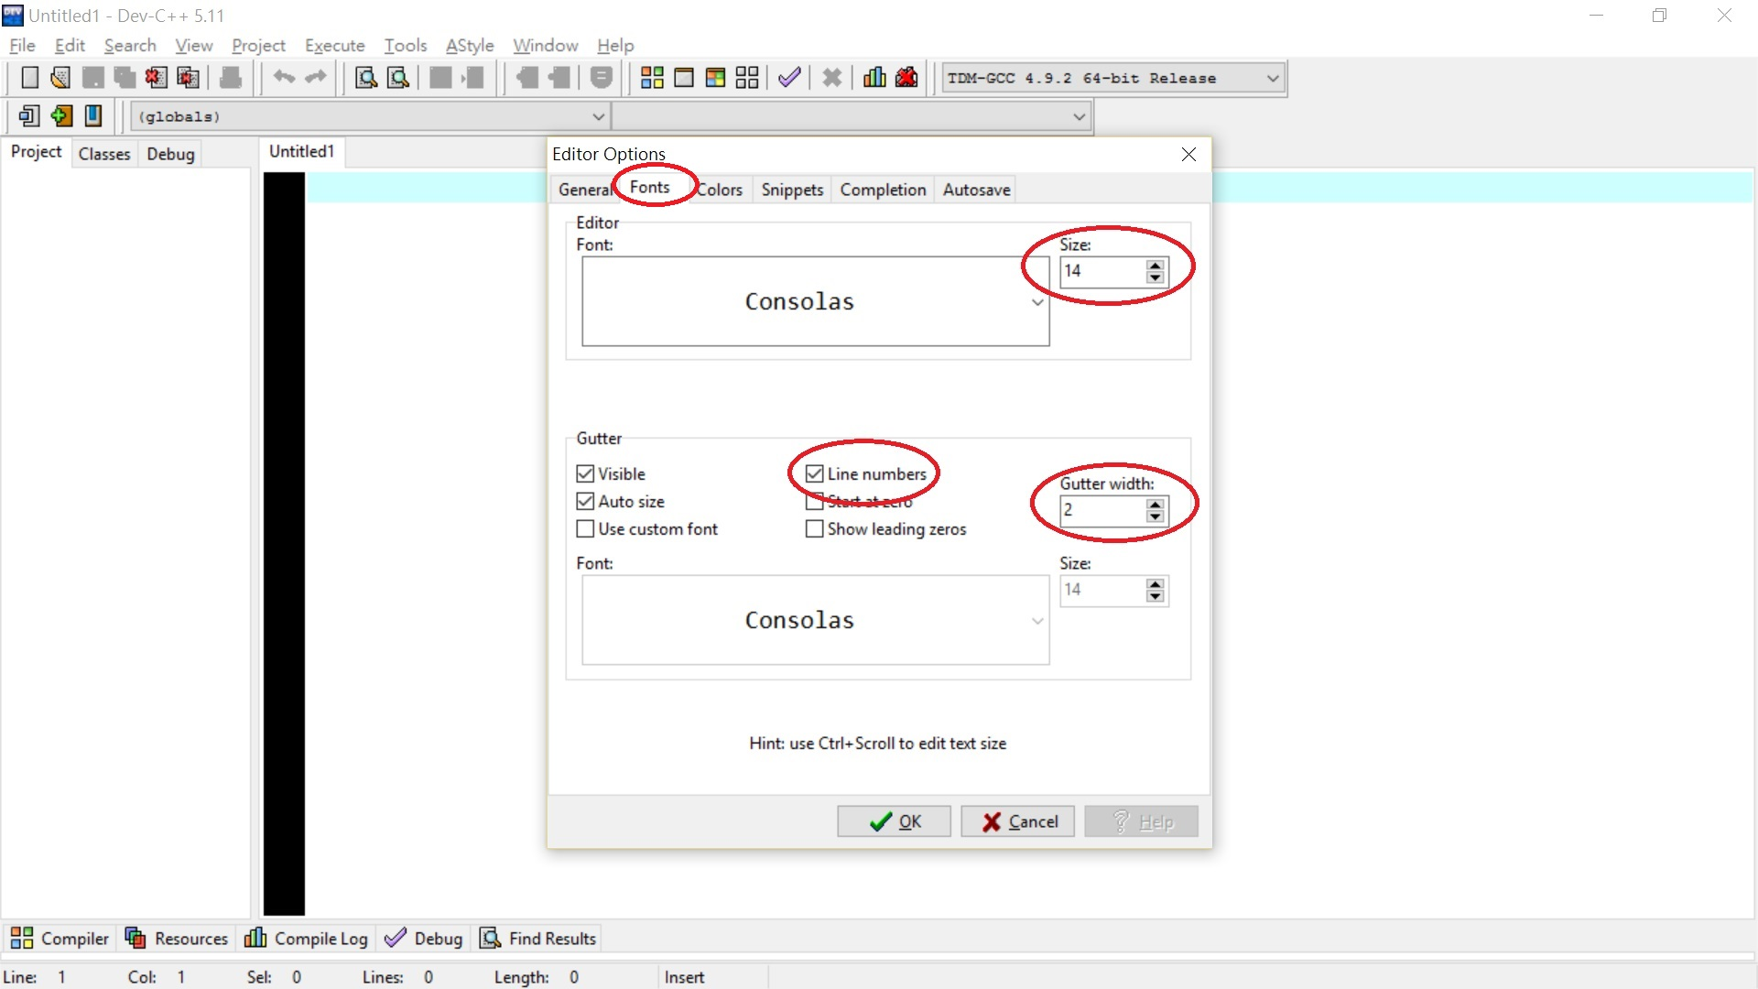
The Dev-C++ will pop up a window allows you to customize the editor window. In the "Fonts" page,
we can modify the font size and enable the line numbers of the editor.

Slide 9
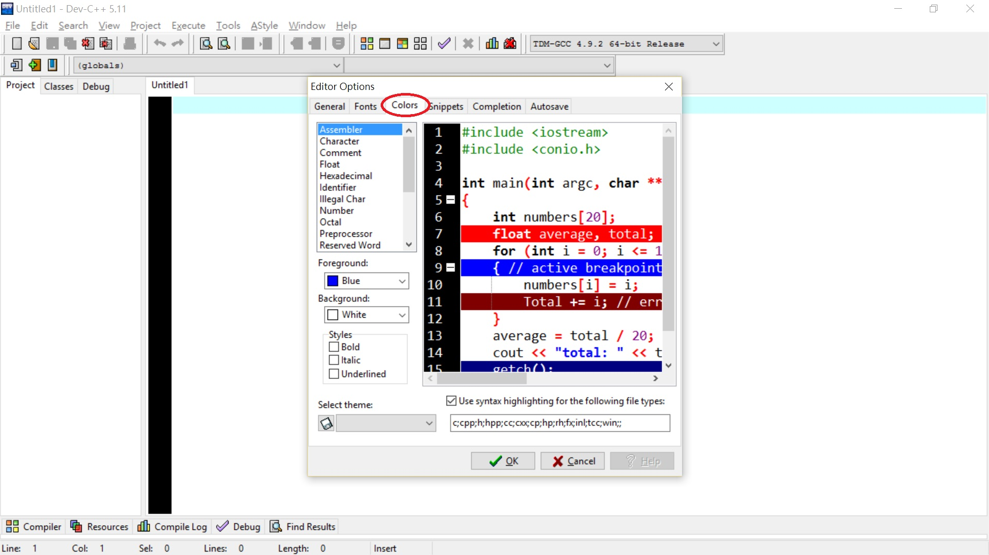
In the "Colors" page, we can modify foreground and background presentation of various elements
in the program text.

Slide 10
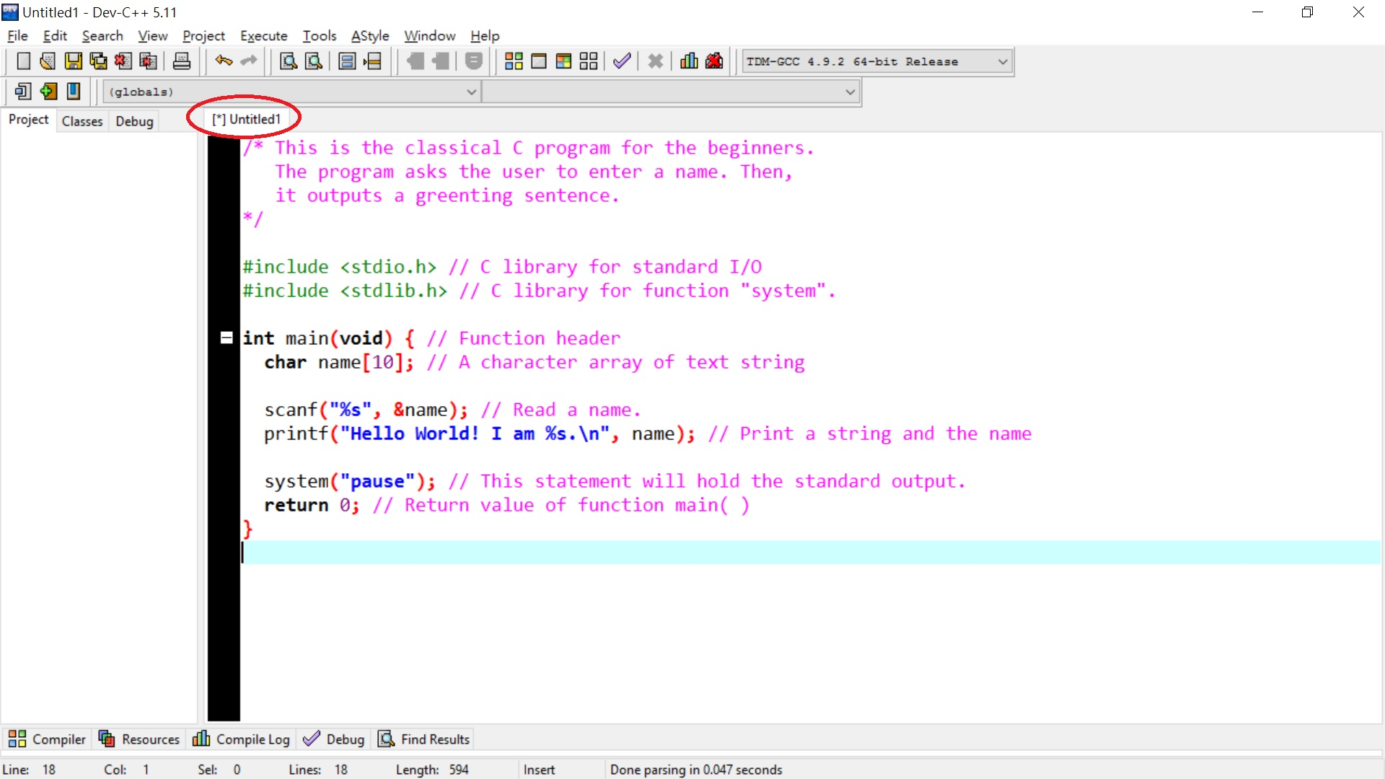
Now, we are ready to enter the program text as below.
Note that the current file name is called "Untitled".

Slide 11
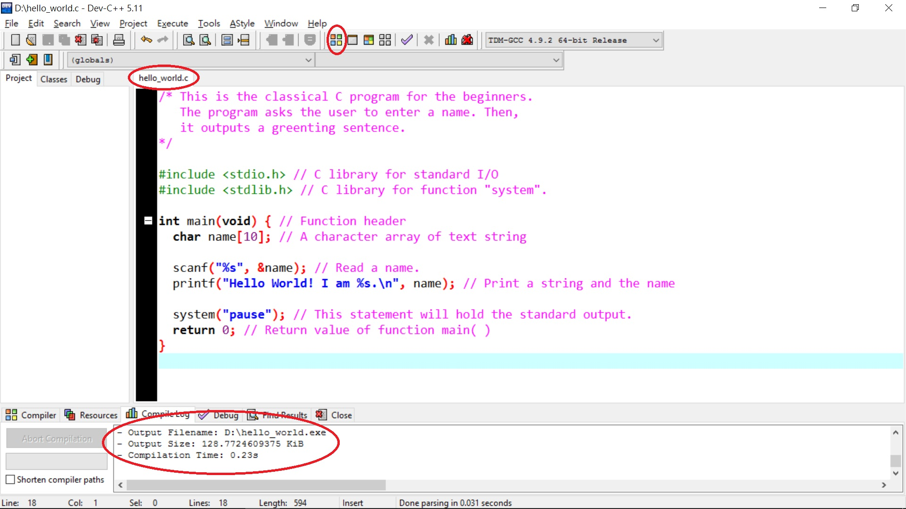
When the program text is entered completely, we click the circled icon to compile the program.
Before the program is compiled, the file name should be changed to a new file name, e.g., "hello_world.c".

Slide 12
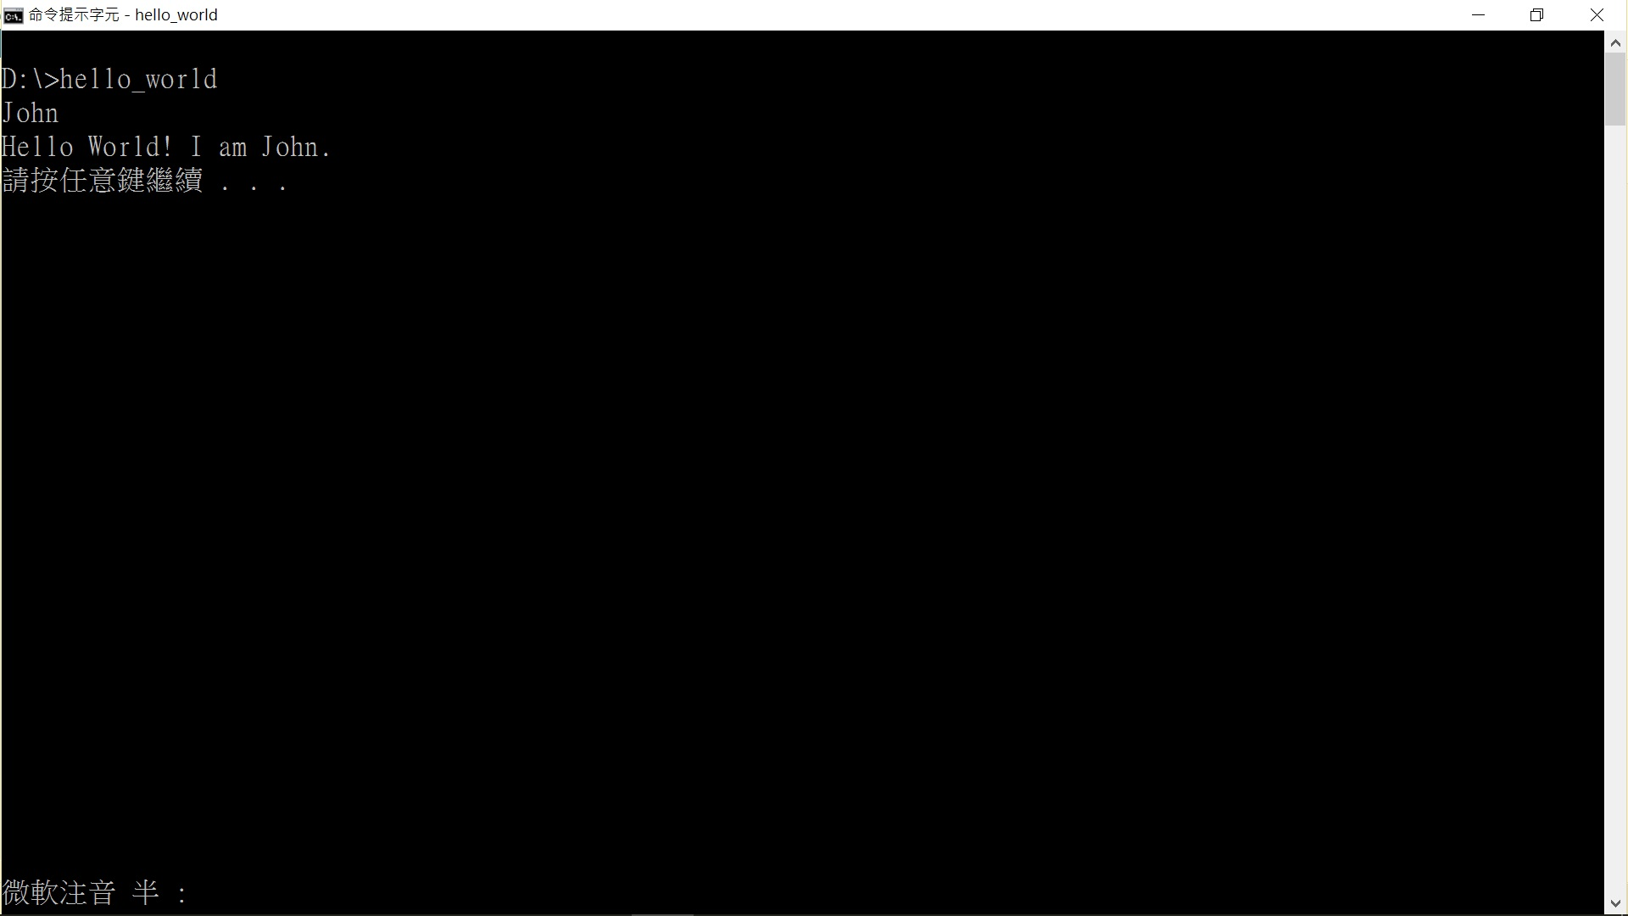
If the program is compiled without any error. The next step is to execute the program.
To run a compiled program, we need to open a Microsoft command window and change the directory to
where the program is. We assume the program is stored in "D:".
To run the program, we simply type the program name "hello_world".

Slide 13
A Simple C Program Example (cont’d)
Line 1 is a preprocessing directive which specify the program will include the standard input/output library called stdio.h.
A C program many include several standard libraries and external C program header files. Each library or external header file must be placed in an #include directive at the beginning of the program.
Lines 3 to 10 are the main program which is a function called main.
A C program is a collection of functions and it must have a main function.
Line 3 is the function head. A function head consists a type of the returned value, name of the function, and a parameter list enclosed in the parentheses.
Reserved word int specifies that the function will return an integer value and void indicates function main does not require any parameter.
Line 4 is a variable declaration which declares a character array name of size 10 (maximum 9 characters).

Slide 14
A Simple C Program Example
Before we study C programming language, we start with a classical program hello_world.c.
line numbers
source code
1
2
3
4
5
6
7
8
9
10
#include <stdio.h>
int main(void) {
char name[10];
scanf("%s", &name);
printf("Hello World! I am %s.\n", name);
return 0;
}
John
Hello World! I am John.
execution result
The red characters denote input data,
and the green characters denote output data.

Slide 15
A Simple C Program Example (cont’d)
Line 6 is an input statement, scanf is an input function in standard library stdio.h.
Format specifier %s means to input a string and this string will be stored in array name indicated by the address operation &name.
Line 7 is an output statement, printf is an output function in standard library stdio.h. "Hello World! I am %s.\n" is the data output by the program. Format specifier %s means to output a string stored in name.
Line 9 is a return statement. It means function main will return 0 when its execution is completed.
The brackets at line 3 and line 10 that encloses the body of a function.
Note that lines 4, 6, 7, and 9 all end with a semicolon which is used to denote the end of a declaration or a statement.

Slide 16
Format Specifiers
A list of frequently used format specifiers is given in the following table:
Specifier | Type
%c | character
%s | character string
%d | integer
%u | unsigned integer in decimal
%o | unsigned integer in octal
%x | unsigned integer in hexadecimal (lower case)
%X | unsigned integer in hexadecimal (upper case)
%l | long integer
%f | floating point number (in fixed-point notation)
%E %e | floating point number (in floating-point notation)

Slide 17
Binary, Octal, and Hexadecimal Numerals
The numeral system we use daily is decimal numerals, i.e., base 10 numbers. In the decimal number system, there are ten symbols, 0, 1, 2, 3, 4, 5, 6, 7, 8, and 9, with decimal points and plus (+) and minus (-) signs to express decimal numbers.
Three other numeral systems are used in computer science, binary numerals (base 2), octal numerals (base 8), and hexadecimal numerals (base 16).
For binary numerals, there are only two digit symbols 0 and 1.
Octal numerals are composed of 8 digit symbols, 0, 1, 2, 3, 4, 5, 6, and 7.
Hexadecimal numerals are composed of 16 digit symbols, 0, 1, 2, 3, 4, 5, 6, 7, 8, 9, A, B, C, D, E, and F.
The English digits, A, B, C, D, E, and F, of hexadecimal numerals, denote decimal values 10, 11, 12, 13, 14, and 15, respectively.

Slide 18
Binary, Octal, and Hexadecimal Numerals (cont’d)
The following table shows the equivalent values of decimal number, binary numbers, octal numbers, and hexadecimal number from 0₁₀ to 15₁₀.
Dec. | Bin. | Oct. | Hex. | Dec. | Bin. | Oct. | Hex.
0 | 0000 | 00 | 0 | 8 | 1000 | 10 | 8
1 | 0001 | 01 | 1 | 9 | 1001 | 11 | 9
2 | 0010 | 02 | 2 | 10 | 1010 | 12 | A
3 | 0011 | 03 | 3 | 11 | 1011 | 13 | B
4 | 0100 | 04 | 4 | 12 | 1100 | 14 | C
5 | 0101 | 05 | 5 | 13 | 1101 | 15 | D
6 | 0110 | 06 | 6 | 14 | 1110 | 16 | E
7 | 0111 | 07 | 7 | 15 | 1111 | 17 | F

Slide 19
Binary, Octal, and Hexadecimal Numerals (cont’d)
A decimal number, say 25084, is an expression of powers of 10, i.e.,
25084=2×10⁴+5×10³+0×10²+8×10¹+4×10⁰.
A binary number, say 101101₂ is an expression of powers of 2, i.e.,
101101₂=1×2⁵+0×2⁴+1×2³+1×2²+0×2¹+1×2⁰=45.
An octal number, say 763₈, is an expression of powers of 8, i.e.,
763₈=7×8²+6×8¹+3×8⁰=499.
A hexadecimal number, say 9E4B₁₆, is an expression of powers of 16, i.e.,
9E4B₁₆=9×16³+14×16²+4×16¹+11×16⁰=40523.
For a number with a fixed length of digits, leading zeros will be added if the length of this number is shorter than the given fixed length.
For example, if we designate a binary number of 8 bits, then 101101₂ is often written as 00101101₂.

Slide 20
Binary, Octal, and Hexadecimal Numerals (cont’d)
Conversion of 40206 to a binary number is illustrated as below:
Input: decimal number d = 40206.
Output: binary number b of the same value as d.
Let b be a "NULL" binary value.
Divided d by 2. Attach the remainder on the left-hand-side of b and set d to be the quotient.
If d≥2, repeat Step 2; otherwise, attach d on the left-hand-side of b.
Operational steps: | Initial: (d, b) = (40206, )
40206 ÷ 2 = 20103 …… 0 | (20103, 0)
20103 ÷ 2 = 10051 …… 1 | (10051, 10)
10051 ÷ 2 = 5025 …… 1 | (5025, 110)
5025 ÷ 2 = 2512 …… 1 | (2512, 1110)
2512 ÷ 2 = 1256 …… 0 | (1256, 01110)

Slide 21
Binary, Octal, and Hexadecimal Numerals (cont’d)
Operational steps: | Initial: (d, b) = (40206, )
1256 ÷ 2 = 628 …… 0 | (628, 001110)
628 ÷ 2 = 314 …… 0 | (314, 0001110)
314 ÷ 2 = 157 …… 0 | (157, 00001110)
157 ÷ 2 = 78 …… 1 | (78, 100001110)
78 ÷ 2 = 39 …… 0 | (39, 0100001110)
39 ÷ 2 = 19 …… 1 | (19, 10100001110)
19 ÷ 2 = 9 …… 1 | (9, 110100001110)
9 ÷ 2 = 4 …… 1 | (4, 1110100001110)
4 ÷ 2 = 2 …… 0 | (2, 01110100001110)
2 ÷ 2 = 1 …… 0 | (1, 001110100001110)
∴ 40206₁₀=1001 1101 0000 1110₂

Slide 22
Binary, Octal, and Hexadecimal Numerals (cont’d)
Conversion of 40206 to a octal number is illustrated as below:
Input: decimal number d = 40206.
Output: octal number o of the same value as d.
Let o be a "NULL" binary value.
Divided d by 8. Attach the remainder on the left-hand-side of o and set d to be the quotient.
If d≥8, repeat Step 2; otherwise, attach d on the left-hand-side of o.
Operational steps: | Initial: (d, o) = (40206, )
40206 ÷ 8 = 5025 …… 6 | (5025, 6)
5025 ÷ 8 = 628 …… 1 | (628, 16)
628 ÷ 8 = 78 …… 4 | (78, 416)
78 ÷ 8 = 9 …… 6 | (9, 6416)
9 ÷ 8 = 1 …… 1 | (1, 16416)
∴ 40206₁₀=116 416₈

Slide 23
Binary, Octal, and Hexadecimal Numerals (cont’d)
Conversion of 40206 to a hexadecimal number is illustrated as below:
Input: decimal number d = 40206.
Output: hexadecimal number h of the same value as d.
Let h be a "NULL" binary value.
Divided d by 16. Attach the remainder on the left-hand-side of h and set d to be the quotient.
If d≥16, repeat Step 2; otherwise, attach d on the left-hand-side of h.
Operational steps: | Initial: (d, h) = (40206, )
40206 ÷16 = 2512 …… 14 | (2512, E)
2512 ÷ 16= 157 …… 0 | (157, 0E)
157 ÷ 16 = 9 …… 13 | (9, D0E)
∴ 40206₁₀=9D0E₁₆

Slide 24
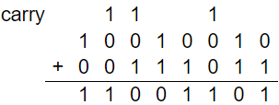
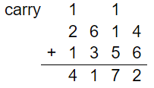
Binary, Octal, and Hexadecimal Numerals (cont’d)
Addition of two binary numbers, 10010010₂+00111011₂:
Addition of two octal numbers, 2614₈+1356₈:

Slide 25
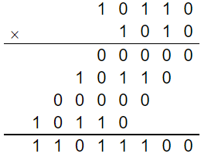
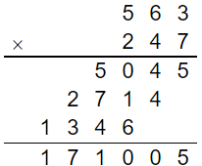
Binary, Octal, and Hexadecimal Numerals (cont’d)
Multiplication of two binary numbers, 10110₂×1010₂:
Multiplication of two octal numbers 563₈×247₈:

Slide 26
Binary, Octal, and Hexadecimal Numerals (cont’d)
Binary numbers, octal numbers, and hexadecimal numbers with decimal points are similar to that of decimal numbers.
For example, binary fractional number 11.101₂ is converted to a decimal fractional number as below:
11.101₂=1×2¹+1×2⁰+1×2⁻¹+0×2⁻²+1×2⁻³=2+1+0.5+0.125=3.625₁₀.

Slide 27
Binary, Octal, and Hexadecimal Numerals (cont’d)
The conversion of a decimal fractional number to a binary number is done in two steps.First, convert the integer part, and then convert the fractional part.
For example, the conversion of 3.625₁₀ to a binary fractional number is done by first converting the integer part 3₁₀ to to 11₂ as before.
The second step is to convert the fractional part 0.625₁₀ to a binary fraction.
The fraction conversion is described and illustrated below.
Input: decimal fraction d = 0.625.
Output: binary fraction b of the same value as d.
Let b be 0. binary value.
Multiply d by 2. Attach the digit in the integer part (either 0 or 1) to the right-hand-side of b and set d to be fractional part of the product.
If d ≠ 0, repeat Step 2; otherwise, stop.

Slide 28
Binary, Octal, and Hexadecimal Numerals (cont’d)
Operational steps: | Initial: (d, b) = (0.625, 0.)
0.625 × 2 = 1.25 | (0.25, 0.1)
0.25 × 2 = 0.5 | (0.5, 0.10)
0.5 × 2 = 1.0 | (0.0, 0.101)
∴ 0.625₁₀=0.101₂

Slide 29
Binary, Octal, and Hexadecimal Numerals (cont’d)
Convert 0.8₁₀ to a binary fraction:
Practically, a decimal fraction is converted to a binary fraction of its approximation with a specific length. For example, if the binary fraction is fixed to 8 bits, 0.8₁₀ is converted to 0.11001100₂ which is actually 0.796875₁₀, an approximation of 0.8₁₀.
Operational steps: | Initial: (d, b) = (0.8, 0.)
0.8 × 2 = 1.6 | (0.6, 0.1)
0.6 × 2 = 1.2 | (0.2, 0.11)
0.2 × 2 = 0.4 | (0.4, 0.110)
0.4 × 2 = 0.8 | (0.8, 0.1100)
0.8 × 2 = 1.6 | (0.6, 0.11001)
0.6 × 2 = 1.2 | (0.2, 0.110011)
0.2 × 2 = 0.4 | (0.4, 0.1100110)
0.4 × 2 = 0.8 | (0.8, 0.11001100)
…… | ……
∴ 0.8₁₀=0.110011001100…₂ (a cyclic binary fraction)

Slide 30
Negative Binary Numbers
A negative number is represented in computer in a specific number of bits.
Two methods for representing negative binary numbers:
One's complement: which is the bitwise NOT of a binary number.
E.g., -37₁₀ = 00100101₂ = 11011010₂.
For 8-bit signed numbers using one's complementonly integers ranges from -127₁₀ (10000000₂) to 127₁₀ (01111111₂) can be expressed.
For example, 320₁₀ cannot be expressed as an 8-bit signed binary number, since 320₁₀ = 1 0100 0000₂ which requires at least 9 bits.
In one's complement, the most significant bit is used as the sign bit. If the most significant bit is 0, the binary number is a positive number; if the most significant bit is 1, the binary number is a negative number.
One's complement has a drawback of two zero's, 00000000₂ and 11111111₂.

Slide 31
Negative Binary Numbers (cont’d)
Two's complement:
For an 8-bit binary number, the most significant bit is used as the sign bit.
The representation of a negative binary number using two's complement is taking the one's complement of its absolute value then adding one to it.
For example, -37₁₀ = 00100101₂ + 1₂ = 11011010₂ + 1₂ = 11011011₂.
For 8-bit signed numbers using two's complement ranges from -128₁₀ (10000000₂) to 127₁₀ (01111111₂).
Note that there is no 128₁₀ of 8-bit two's complement binary numbers.

Slide 32
Characters
Characters are represented in a computer as a bit string.
The most popular encoding scheme of English characters is ASCII encoding (American Standard Code for Information Interchange).
Each character of ASCII code occupies one byte, but only seven bits are used.
The most significant bit of ASCII code is always 0.
The character set ASCII code is divided into two categories: control characters and printable characters.
The printable characters range from decimal values 32 to 126.
Unicode is an international standard of character encoding of all human written languages developed by International Organization for Standardization (ISO).
Unicode has been adopted by many computer systems to support multilingual environments.
Unicode is designed as both 8-bit, UTF-8, and 16-bit, UTF-16, coding schemes for different languages.

Slide 33
Characters (cont’d)
Two Chinese character encoding schemes: Big5 for traditional Chinese characters, GB for simplified Chinese characters.
Big5 and GB are all 16-bit encoding schemes.

Slide 34
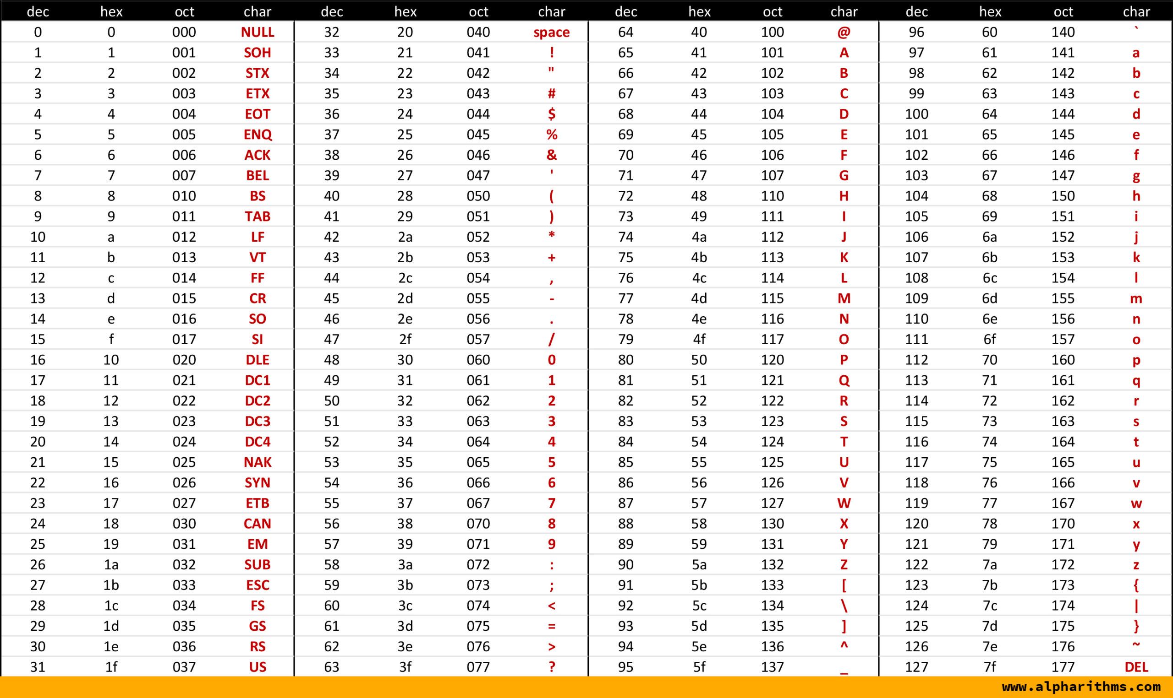

Slide 35
Primitive Data Types in C
A C program contains a number of variables each of which represents a memory location.
Each program variable must be declared as an instance of a data type.
Three basic types in C programming language: characters, integers, and floating-point numbers.
Character type is considered as single-byte integers.
Integer and floating-point types have several variations.
Each primitive data type has specific memory size (in bytes) and value ranges.

Slide 37
Function sizeof()
The size of a data type depends on the size of a computer's CPU.
The sizes in the previous table may vary from one computer to another.
Program size_of.c outputs the size of each data type using a C library function sizeof() which receives a type name and returns the number of bytes of that type.

Slide 38
size_of.c
size_of.exe
#include <stdio.h>
int main(void) {
printf("Memory size of C primitive data types (bytes): \n");
printf(" char: %d\n", sizeof(char));
printf(" int: %d\n", sizeof(int));
printf(" short: %d\n", sizeof(short));
printf(" long: %d\n", sizeof(long));
printf(" long long: %d\n", sizeof(long long));
printf(" unsigned: %d\n", sizeof(unsigned));
printf(" unsigned short: %d\n", sizeof(unsigned short));
printf(" unsigned long: %d\n", sizeof(unsigned long));
printf(" unsigned long long: %d\n", sizeof(unsigned long long));
printf(" float: %d\n", sizeof(float));
printf(" double: %d\n", sizeof(double));
return 0;
}
Memory size of C primitive data types (bytes):
char: 1
int: 4
short: 2
long: 4
long long: 8
unsigned: 4
unsigned short: 2
unsigned long: 4
unsigned long long: 8
float: 4
double: 8

Slide 39
Character Data Type in C
In C programs, a character constant is expressed with a pair of single quotation, e.g., 'A', 'a', ';', etc., and is encoded using ASCII encoding scheme.
Most of the printable characters can appear as a character by itself.
However, a small set of characters must be attached a backslash symbol at the front to form a character in order to avoid ambiguity. A character with a backslash at the front is called an escape sequence.
Escape sequences including some control characters of C programming language.

Slide 41

Strings in C
In C programs, a string is declared as an array of multiple characters ending with a null character.
Program characters.c manipulates a string and prints out the original and new string.
Line 4 declares string as an array of 10 characters and assign the initial values as ABC.
Line 6 outputs the original string. Lines 7 through 13, change the contents of string.
Octal number 131₈ is the ASCII code of character ‘Y’ and hexadecimal number 5A₁₆ is the ASCII code of character ‘Z’.
The content of character array string is shown below:

Slide 42
characters.c
characters.exe
1
2
3
4
5
6
7
8
9
10
11
12
13
14
15
16
17
#include <stdio.h>
int main(void) {
char string[10] = {'A', 'B', 'C', '\0'};
printf("The original string: %s\n", string);
string[3] = '\t'; // horizontal tab
string[4] = '\\'; // backslash
string[5] = '\"'; // double quote
string[6] = 'X'; // character X
string[7] = '\131'; // character Y
string[8] = '\x5A'; // character Z
string[9] = '\0'; // null
printf("The new string: %s\n", string);
return 0;
}
The original string: ABC
The new string: ABC \"XYZ

Slide 43
Integer Type in C
Program integer_max_min.c shows the maximum and minimum values of type int.
Program integer_short_long.c shows that assigning a variable of the normal integer type to a variable of the short integer type (Line 10) may cause the overflow problem. But, it is not a problem of assigning a variable of the normal integer type to a variable of the long integer type (Line 12) is allowed.

Slide 44
integer_max_min.c
integer_max_min.exe
1
2
3
4
5
6
7
8
9
10
11
12
13
14
15
16
#include <stdio.h>
int main(void) {
int i;
i = 2147483647;
printf("maximum integer value: %d\n", i);
i = 2147483648;
printf("integer overflow: %d\n", i);
i = -2147483648;
printf("minimum integer value: %d\n", i);
i = -2147483649;
printf("integer underflow: %d\n", i);
return 0;
}
maximum integer value: 2147483647
integer overflow: -2147483648
minimum integer value: -2147483648
integer underflow: 2147483647

Slide 45
integer_short_long.c
integer_short_long.exe
1
2
3
4
5
6
7
8
9
10
11
12
13
14
15
16
#include <stdio.h>
int main(void) {
int i;
short j;
long k;
i = 158423;
printf("normal integer: %d\n", i);
j = i;
printf("short integer (overflow): %d\n", j);
k = i;
printf("long integer: %d\n", k);
return 0;
}
normal integer: 158423
short integer (overflow): 27351
long integer: 158423

Slide 46
Floating Type in C
Program float_format.c shows the output of 134.56789 in fixed-point format and floating-point format.
Note that the output values are not exactly 134.5678 since floating-point representation is only an approximation.

Slide 47
float_format.c
float_format.exe
1
2
3
4
5
6
7
8
9
10
11
#include <stdio.h>
int main(void) {
float r;
r = 134.56789;
printf("fixed-point format: %f\n", r);
printf("floating-point format: %E\n", r);
return 0;
}
fixed-point format: 134.567886
floating-point format: 1.345679E+002

Slide 48
More Format Specification
Additional format specification can be added to an integer specifier or a floating-point specifier to make the output more friendly.
Program specifier.c shows some examples of length and precision format.
Integer specifier %4d will output an integer occupying at least four character positions by filling spaces at the left-hand-side (right alignment), if the length of the integer (including sign symbol) is less than 4;
Integer specifier %-4d will output an integer occupying at least four character positions by filling spaces at the right-hand-side (left alignment), if the length of the integer (including sign symbol) is less than 4;
the output will occupy whatever the length of the integer, if this length is greater than or equal to four.
Specifier %6.2f will print a floating point number of minimum width six positions such that at least three integer digits, the decimal point, and two fractional digits (two-digit precision).

Slide 49
specifier.c
specifier.exe
1
2
3
4
5
6
7
8
9
10
11
12
13
14
15
16
#include <stdio.h>
int main(void) {
printf("%4d.\n", 12);
printf("%4d.\n", -8);
printf("%4d.\n", 12345);
printf("%-4d.\n", 12);
printf("%-4d.\n", -8);
printf("%-4d.\n", 12345);
printf("%6.2f\n", 2.5);
printf("%6.2f\n", 32.533);
printf("%6.2f\n", 3232.533);
return 0;
}
12.
-8.
12345.
12 .
-8 .
12345.
2.50
32.53
3232.53

Slide 50
Strongly Typed Programming Language
In the theory of programming languages, a strongly typed language allows a compiler to check type errors during compile time.
However, C programming language is not strictly confined to strongly type checking for it allows assignment of variables of different type to each other.
Program primitve_type_not_casting.c tries to print variables of character type, integer type, and floating-point type. The program goes through compilation without any error, but the output shows some of the values have incorrect results.
To ensure program correctness, proper type casting must be added in front of a variable.
Type casting is explicitly to add the name of the intentional type in front of a variable or an expression that it will converted to.
Program primitve_type_casting.c shows explicitly type casting.

Slide 51
primitve_type_not_casting.c
primitve_type_not_casting.exe
1
2
3
4
5
6
7
8
9
10
11
12
13
14
15
16
17
18
19
#include <stdio.h>
int main(void) {
char c;
int i;
float r;
c = 'A';
printf("Character as integer: %d\n", c);
printf("Character as floating-point: %E\n", c);
i = 49;
printf("Integer as character: %c, %X\n", i, i);
printf("Integer as floating-point: %E\n", i);
r = 97.512;
printf("Floating-point as character: %c, %X\n", r, r);
printf("Floating-point as integer: %d\n", r);
return 0;
}
Character as integer: 65
Character as floating-point: 5.284007E-308
Integer as character: 1, 31
Integer as floating-point: 1.039778E-312
Floating-point as character: , 405860C4
Floating-point as integer: -1610612736
The output shows printing a character as an
integer (Line 9) or an integer as a character
(Line 12) yields a correct answer.
However, printing a character or an integer
as a floating-point number (Lines 10 and 13)
or printing a floating-point number as a
character or an integer (Lines 15 and 16) will
yield incorrect answer.

Slide 52
primitve_type_casting.c
1
2
3
4
5
6
7
8
9
10
11
12
13
14
15
16
17
18
19
#include <stdio.h>
int main(void) {
char c;
int i;
float r;
c = 'A';
printf("Character as integer: %d\n", c);
printf("Character as floating-point: %E\n", (float) c);
i = 49;
printf("Integer as character: %c, %X\n", i, i);
printf("Integer as floating-point: %E\n", (float) i);
r = 97.512;
printf("Floating-point as character: %c, %X\n", (char) r, (char) r);
printf("Floating-point as integer: %d\n", (int) r);
return 0;
}
In Lines 10 and 13 of program, character variable c and integer variable i are explicitly casted to type float.
In Lines 15 and 16, floating-point variable r is casted to type char and int.

Slide 53
primitve_type_casting.exe
Character as integer: 65
Character as floating-point: 6.500000E+001
Integer as character: 1, 31
Integer as floating-point: 4.900000E+001
Floating-point as character: a, 61
Floating-point as integer: 97
With proper castings, the output gives correct values. Character A is converted to floating-point number 6.500000E+001 and integer 49 is converted to floating-point number 4.900000E+001.
When a floating-point number is casted to char or int, its fractional part is simply removed. Integer 97 is exactly the decimal value of ASCII code of character a.

